Slide 1

The Battle of Hotels in Athens
Evangelos Bezianis

Slide 2
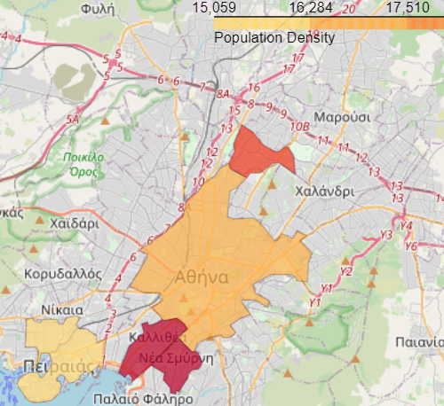
Population Density in Athens
GeoJSON
read_html()
Follium

Slide 3
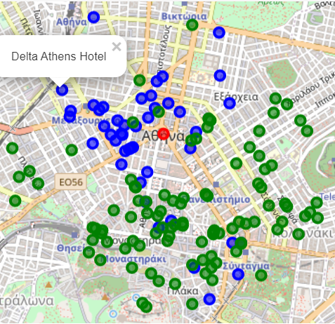
Hotels and Venues in Athens
Forsquare API

Slide 4
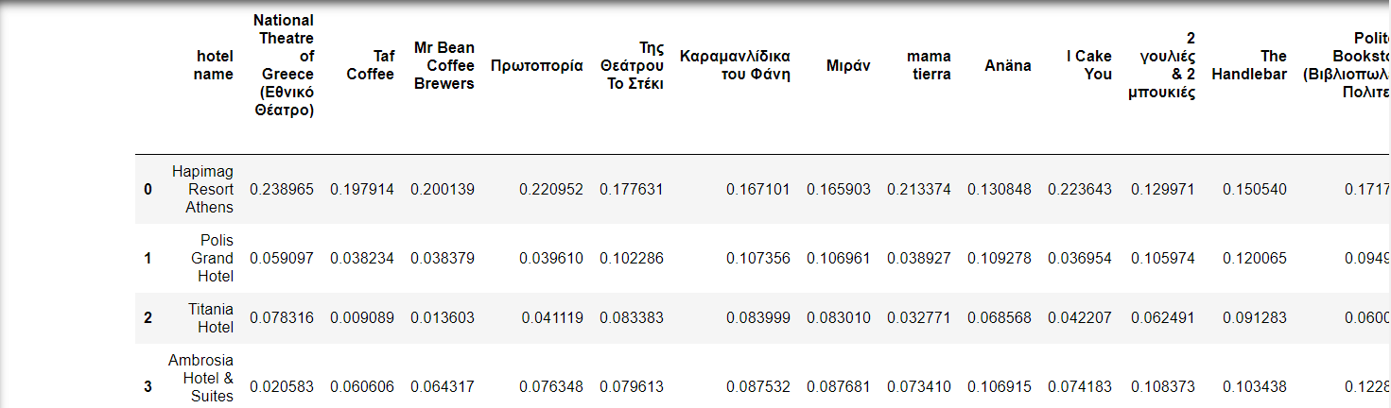
Distance of Hotels from each venue
tolist()
Coordinates to Euclidian distance

Slide 5
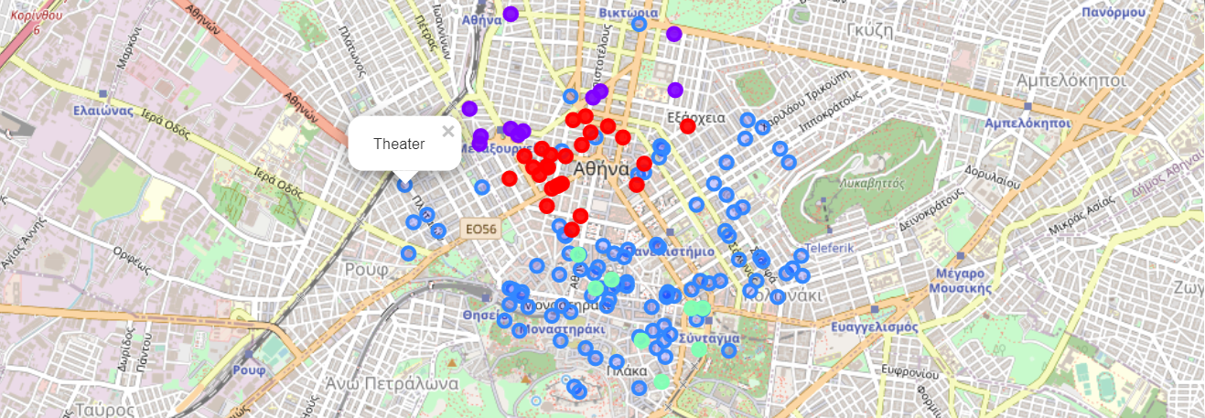
Clusters on Map
K-Means clustering

Slide 6
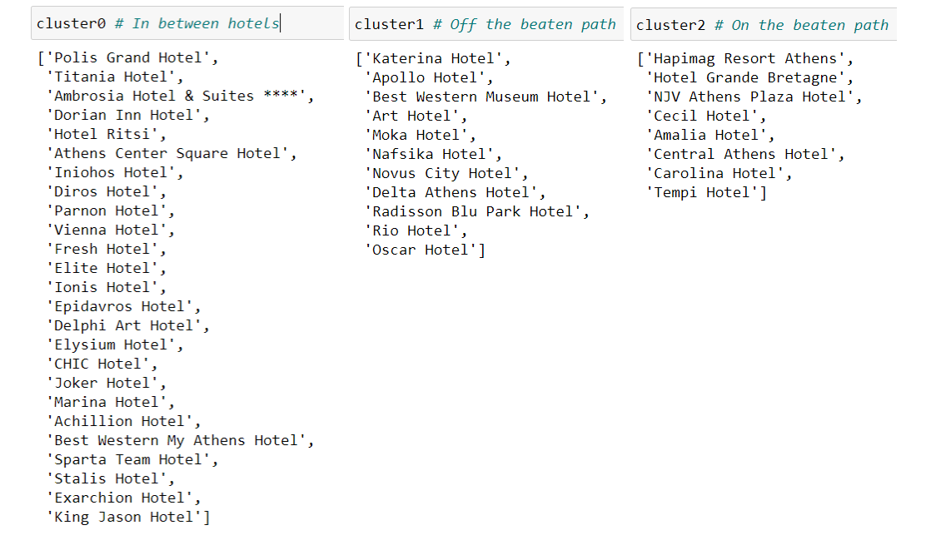
Clusters in List
Where would you stay?

